Slide 1
Chapter 2: Attacks, Concepts and Techniques
Instructor Materials
Introduction to Cybersecurity v2.1
Notes:
Cisco Networking Academy Program
Introduction to Cybersecurity v2.1
Chapter 2: Attacks, Concepts and Techniques

Slide 2
Instructor Materials – Chapter 2 Planning Guide
This PowerPoint deck is divided in two parts:
Instructor Planning Guide
Information to help you become familiar with the chapter
Teaching aids
Instructor Class Presentation
Optional slides that you can use in the classroom
Begins on slide # 9
Note: Remove the Planning Guide from this presentation before sharing with anyone.
Notes:
2

Slide 3
Chapter 2: Attacks, Concepts and Techniques
Introduction to Cybersecurity v2.1
Planning Guide
Notes:
Cisco Networking Academy Program
Introduction to Cybersecurity v2.0
Chapter 2: Attacks, Concepts and Techniques

Slide 4
Chapter 2: Activities
What activities are associated with this chapter?
Page # | Activity Type | Activity Name
2.1.2.2 | Interactive Activity | Identify Vulnerability Terminology
2.1.3.3 | Interactive Activity | Identify Malware Types
2.1.5.4 | Interactive Activity | Identify the DoS Type
Notes:
4

Slide 5
Chapter 2: Assessment
Students should complete Chapter 2, “Assessment” after completing Chapter 2.
Quizzes and other activities can be used to informally assess student progress.
Notes:
5

Slide 6
Chapter 2: Best Practices
Prior to teaching Chapter 2, the instructor should:
Complete Chapter 2, “Assessment.”
Review the Additional Resources and Activities document in the Student Resources for possible additional resources and activities.
The objectives of this chapter are:
Explain how a security vulnerability is exploited.
Identify examples of security vulnerabilities.
Describe types of malware and their symptoms.
Describe methods of infiltration.
Describe methods used to deny service.
Describe a blended attack.
Describe the importance of impact reduction.
Notes:
6

Slide 7
Chapter 2: Additional Help
For additional help with teaching strategies, including lesson plans, analogies for difficult concepts, and discussion topics, visit the Community Forums .
If you have lesson plans or resources that you would like to share, upload them to the Community Forums in order to help other instructors.
Notes:
7

Slide 9
Chapter 2: Attacks, Concepts and Techniques
Introduction to Cybersecurity v2.1
Notes:
Cisco Networking Academy Program
Introduction to Cybersecurity v2.1
Chapter 2: Attacks, Concepts and Techniques

Slide 10
Chapter 2 - Sections & Objectives
2.1 Analyzing a Cyberattack
Explain the characteristics and operation of a cyber attack.
Explain how a security vulnerability is exploited.
Identify examples of security vulnerabilities.
Describe types of malware and their symptoms.
Describe methods of infiltration.
Describe methods used to deny service.
2.2 The Cybersecurity Landscape
Explain trends in the cyberthreat landscape.
Describe a blended attack.
Describe the importance of impact reduction.
Notes:
10
Cisco Networking Academy Program
Introduction to Cybersecurity v2.1
Chapter 2: Attacks, Concepts and Techniques

Slide 11
2.1 Analyzing a Cyberattack
Notes:
2 - Attacks, Concepts and Techniques
2.1 – Analyzing a Cyberattack

Slide 12

Security Vulnerability and Exploits Finding Security Vulnerabilities
An exploit is the term used to describe a program written to take advantage of a known vulnerability.
An attack is the act of using an exploit against a vulnerability.
Software vulnerability
Errors in OS or application code
SYNful Knock – Vulnerability in Cisco IOS
allows attackers to gain control of the routers
monitor network communication
infect other network devices.
Project Zero – Google formed a permanent team dedicated to finding software vulnerabilities.
Hardware vulnerability
Hardware design flaws
Rowhammer - RAM memory exploit allows data to be retrieved from nearby address memory cells.
Notes:
2.1 – Analyzing a Cyberattack
2.1.1 – Security Vulnerability and Exploits
2.1.1.1 – Finding Security Vulnerabilities

Slide 13

Types of Security Vulnerabilities Categorizing Security Vulnerabilities
Buffer Overflow
Data is written beyond the limits of a buffer
Non-validated Input
Force programs to behave in an unintended way
Race Conditions
Improperly ordered or timed events
Weaknesses in Security Practices
Protect sensitive data through authentication, authorization, and encryption
Access-control Problems
Access control to physical equipment and resources
Security practices
Notes:
2.1 – Analyzing a Cyberattack
2.1.2 – Types of Security Vulnerabilities
2.1.2.1 – Categorizing Security Vulnerabilities

Slide 14
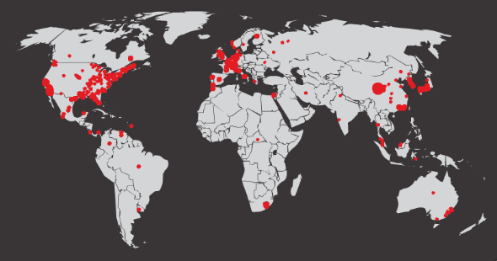
Types of Malware and Symptoms Types of Malware
Malware is used to steal data, bypass access controls, cause harm to, or compromise a system.
Types of Malware
Spyware - track and spy on the user
Adware - deliver advertisements, usually comes with spyware
Bot - automatically perform action
Ransomware - hold a computer system or the data captive until a payment is made
Scareware - persuade the user to take a specific action based on fear.
Initial Code Red Worm Infection
Notes:
2.1 – Analyzing a Cyberattack
2.1.3 – Types of Malware and Symptoms
2.1.3.1 – Types of Malware

Slide 15
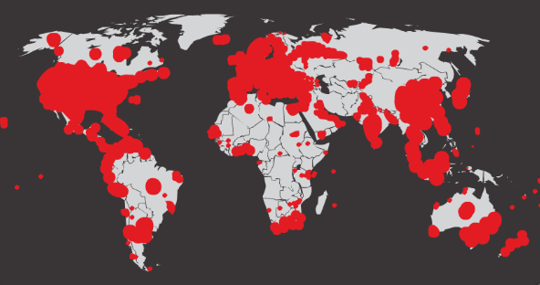
Types of Malware and Symptoms Types of Malware (Cont.)
Types of Malware (Cont.)
Rootkit - modify the operating system to create a backdoor
Virus - malicious executable code that is attached to other executable files
Trojan horse - carries out malicious operations under the guise of a desired operation
Worm - replicate themselves by independently exploiting vulnerabilities in networks
Man-in-The-Middle or Man-in-The-Mobile – take control over a device without the user’s knowledge
Code Red Worm Infection 19 Hours Later
Notes:
2.1 – Analyzing a Cyberattack
2.1.3 – Types of Malware and Symptoms
2.1.3.1 – Types of Malware

Slide 16

Types of Malware and Symptoms Symptoms of Malware
There is an increase in CPU usage.
There is a decrease in computer speed.
The computer freezes or crashes often.
There is a decrease in Web browsing speed.
There are unexplainable problems with network connections.
Files are modified.
Files are deleted.
There is a presence of unknown files, programs, or desktop icons.
There are unknown processes running.
Programs are turning off or reconfiguring themselves.
Email is being sent without the user’s knowledge or consent.
Notes:
2.1 – Analyzing a Cyberattack
2.1.3 – Types of Malware and Symptoms
2.1.3.2 – Symptoms of Malware

Slide 17

Methods of Infiltration Social Engineering
Social Engineering – manipulation of individual into performing actions or divulging confidential information
Pretexting - an attacker calls an individual and lies to them in an attempt to gain access to privileged data.
Tailgating - an attacker quickly follows an authorized person into a secure location.
Something for something (Quid pro quo) - an attacker requests personal information from a party in exchange for something
Notes:
2.1 – Analyzing a Cyberattack
2.1.4 – Methods of Infiltration
2.1.4.1 – Social Engineering

Slide 18

Methods of Infiltration Wi-Fi Password Cracking
Wi-Fi Password Cracking – Password discovery
Social engineering - The attacker manipulates a person who knows the password into providing it.
Brute-force attacks - The attacker tries several possible passwords in an attempt to guess the password.
Network sniffing - The password maybe discovered by listening and capturing packets send on the network.
Notes:
2.1 – Analyzing a Cyberattack
2.1.4 – Methods of Infiltration
2.1.4.2 – Wi-Fi Password Cracking

Slide 19

Methods of Infiltration Phishing
Phishing
malicious party sends a fraudulent email disguised as being from a legitimate, trusted source
trick the recipient into installing malware on their device or sharing personal or financial information
Spear phishing
a highly targeted phishing attack
Notes:
2.1 – Analyzing a Cyberattack
2.1.4 – Methods of Infiltration
2.1.4.3 - Phishing

Slide 20
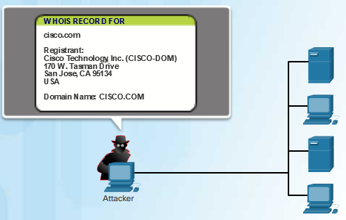
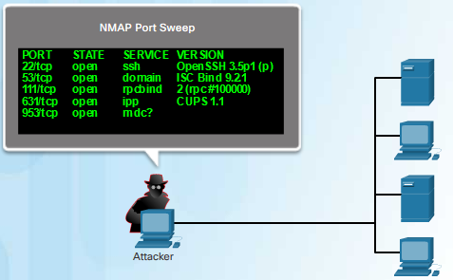
Methods of Infiltration Vulnerability Exploitation
Vulnerability Exploitation – scan to find vulnerability to exploit
Step 1 - Gather information about the target system using port scanner or social engineering
Step 2 - Determine learned information from step 1
Step 3 - Look for vulnerability
Step 4 - Use a known exploit or write a new exploit
Advanced Persistent Threats – a multi-phase, long term, stealthy and advanced operation against a specific target
usually well-funded
deploy customized malware
Notes:
2.1 – Analyzing a Cyberattack
2.1.4 – Methods of Infiltration
2.1.4.4 – Vulnerability Exploitation

Slide 21
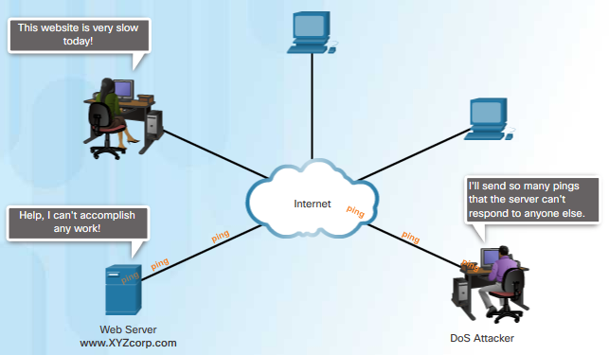
Denial of Service DoS
DoS is a disruption of network services
Overwhelming quantity of traffic - a network, host, or application is sent an enormous quantity of data at a rate which it cannot handle
Maliciously formatted packets - maliciously formatted packet is sent to a host or application and the receiver is unable to handle it
Notes:
2.1 – Analyzing a Cyberattack
2.1.5 – Denial of Service
2.1.5.1 - DoS

Slide 22
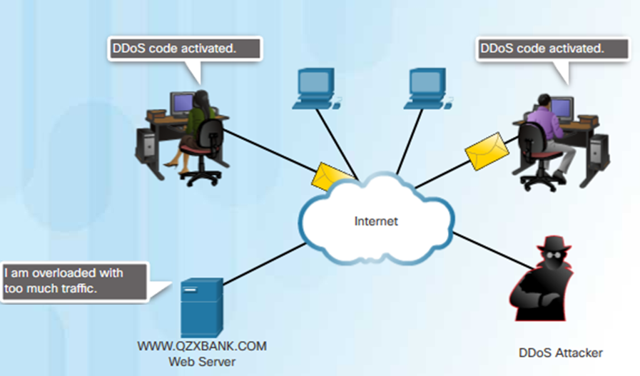
Denial of Service DDoS
Similar to DoS, from multiple, coordinated sources
Botnet - a network of infected hosts
Zombie - infected hosts
The zombies are controlled by handler systems.
The zombies continues to infect more hosts, creating more zombies.
Notes:
2.1 – Analyzing a Cyberattack
2.1.5 – Denial of Service
2.1.5.2 - DDoS

Slide 23

Denial of Service SEO Poisoning
SEO
Search Engine Optimization
Techniques to improve a website’s ranking by a search engine
SEO Poisoning
Increase traffic to malicious websites
Force malicious sites to rank higher
Notes:
2.1 – Analyzing a Cyberattack
2.1.5 – Denial of Service
2.1.5.3 – SEO Poisoning

Slide 24
2.2 The Cybersecurity Landscape
Notes:
2 - Attacks, Concepts and Techniques
2.2 - The Cybersecurity Landscape

Slide 25

Blended Attack What is a Blended Attack?
Uses multiple techniques to compromise a target
Uses a hybrid of worms, Trojan horses, spyware, keyloggers, spam and phishing schemes
Common blended attack example
spam email messages, instant messages or legitimate websites to distribute links
DDoS combined with phishing emails
Examples: Nimbda, CodeRed, BugBear, Klez, Slammer, Zeus/LICAT, and Conficker
Notes:
2.2 - The Cybersecurity Landscape
2.2.1 – Blended Attack
2.2.1.1 – What is a Blended Attack?

Slide 26

Impact Reduction What is Impact Reduction?
Communicate the issue
Be sincere and accountable
Provide details
Understand the cause of the breach
Take steps to avoid another similar breach in the future
Ensure all systems are clean
Educate employees, partners and customers
Notes:
2.2 - The Cybersecurity Landscape
2.2.2 – Impact Reduction
2.2.2.1 – What is Impact Reduction?

Slide 27
2.3 Chapter Summary
Notes:
2 – Attacks, Concepts and Techniques
2.3 – Summary

Slide 28
Chapter Summary Summary
Identify examples of security vulnerabilities.
Explain how a security vulnerability is exploited.
Describe types of malware and their symptoms, methods of infiltration, methods used to deny service.
Describe a blended attack and the importance of impact reduction.
Notes:
2.3 – Chapter Summary
2.3.1.1 – Summary

